Slide 1

By Rahul BalvantBhai Patel
Business Analyst Career Program - Capstone Project

Slide 2

Agenda
Data Exploration
Statistical Analysis using Excel
Graphical Analysis using Excel
Insert the given data into the SQL server
Import the Data from the SQL Database into PowerBI
Interactive Dashboard by using visualization tools
Conclusion and Inferences
Endnotes

Slide 3
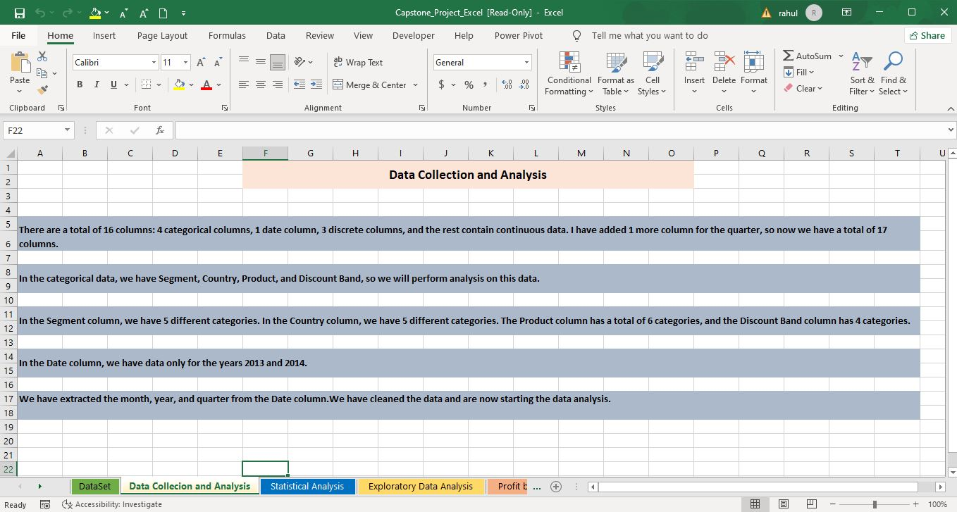
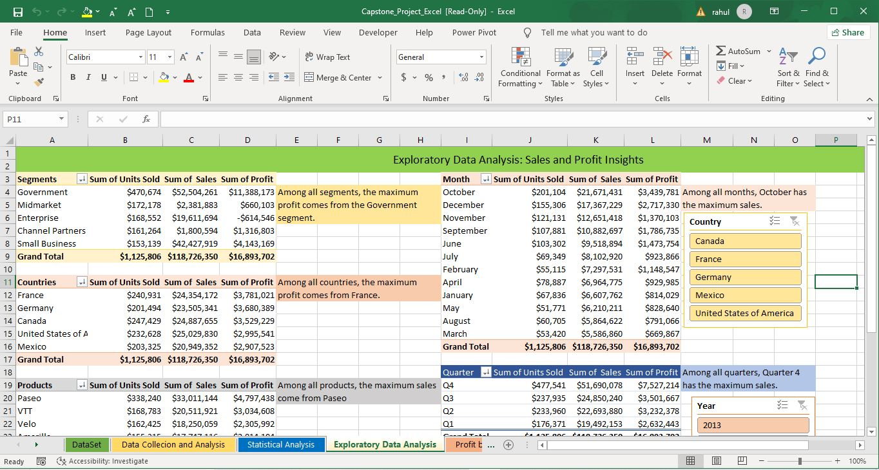
Data Exploration
Initially, I conducted a thorough data exploration and calculated the key metrics. The dataset comprises 6 products sold across 5 countries within 5 distinct segments.

Slide 4
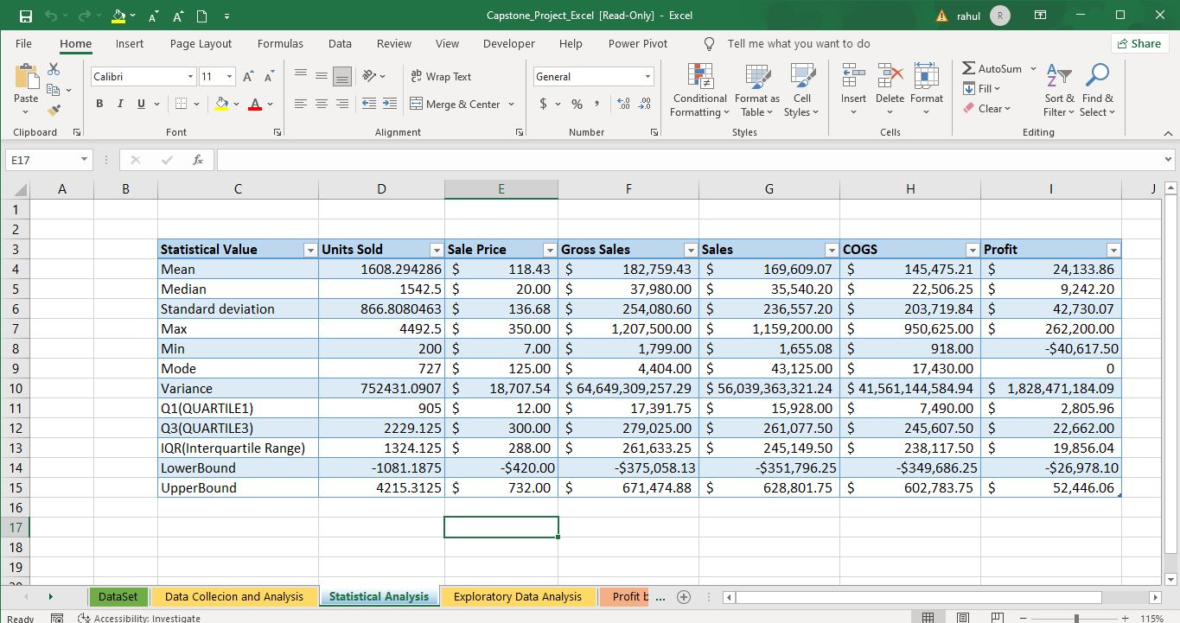
Statistical Analysis using Excel
I conducted a range of statistical analyses, including mean, median, mode, standard deviation, variance, quartile 1, quartile 3, and interquartile range on sales and profit data.

Slide 5
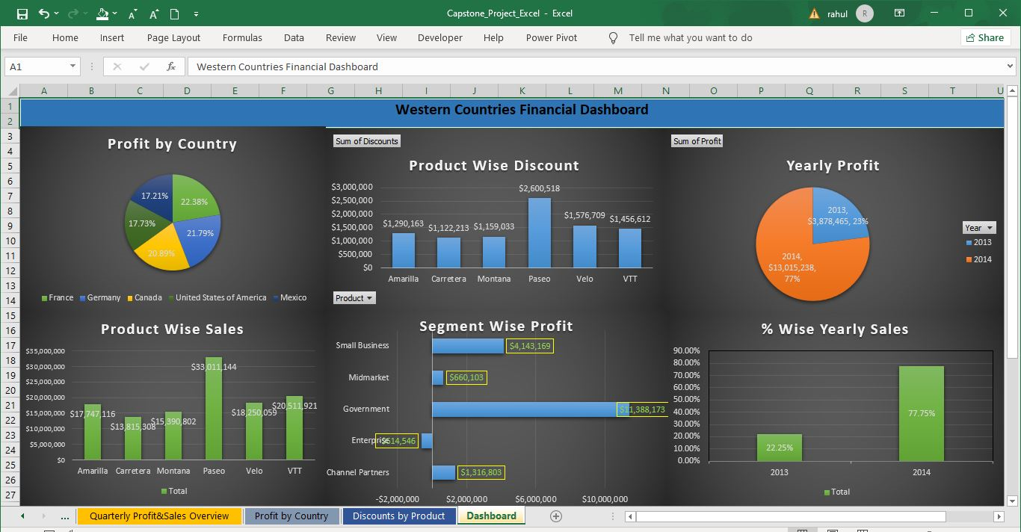
Graphical Analysis using Excel
Please find my interactive Excel dashboard featuring comprehensive graphical analysis.

Slide 6
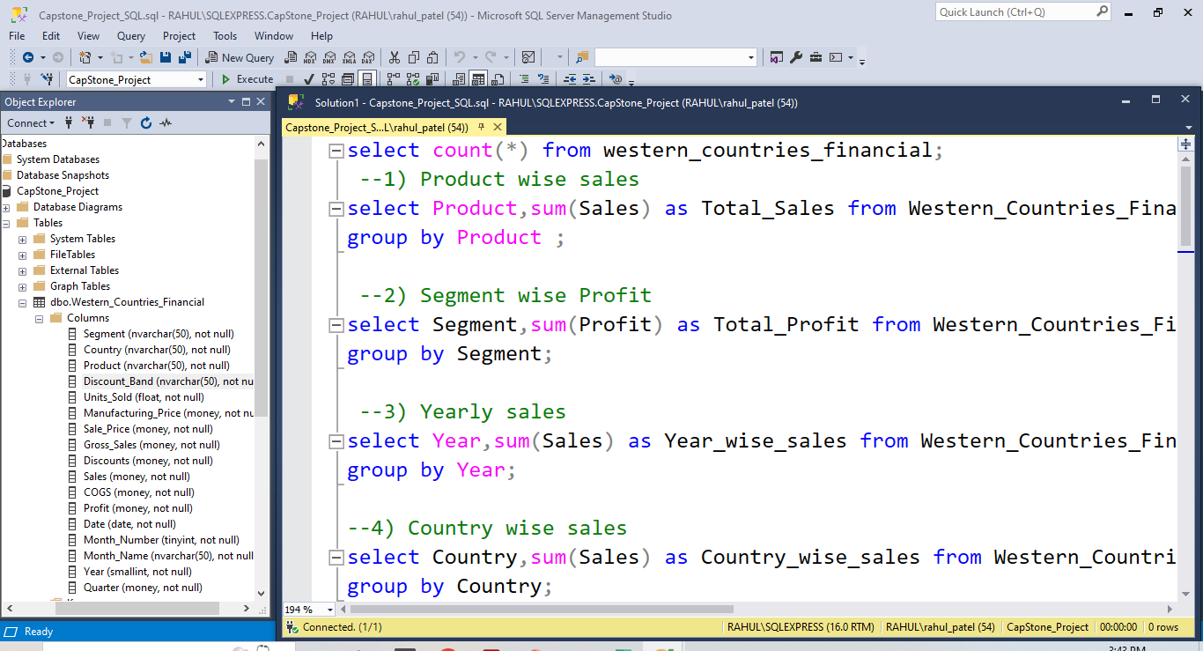
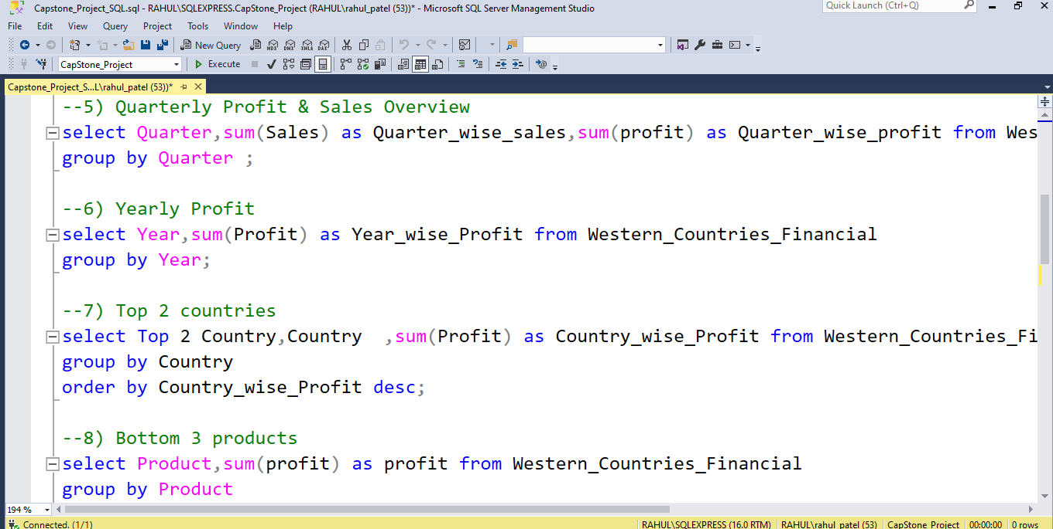
Insert the given data into the SQL server
I have uploaded the Excel data into SQL Server and executed several basic queries to analyze the information.

Slide 7
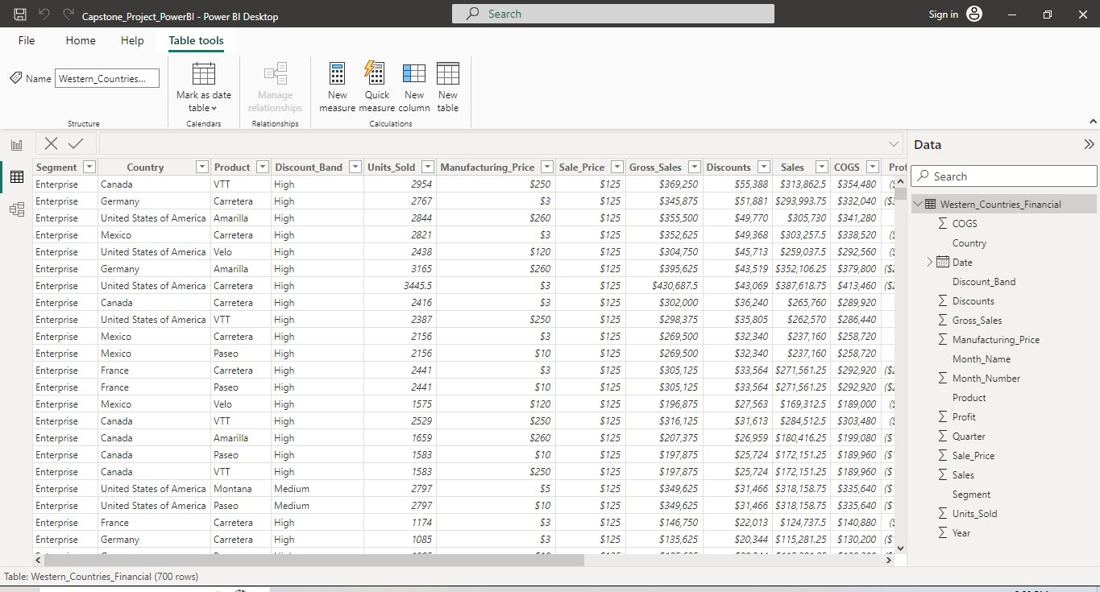
Import the Data from the SQL Database into PowerBI
The data has been successfully imported from SQL Server into Power BI.

Slide 8
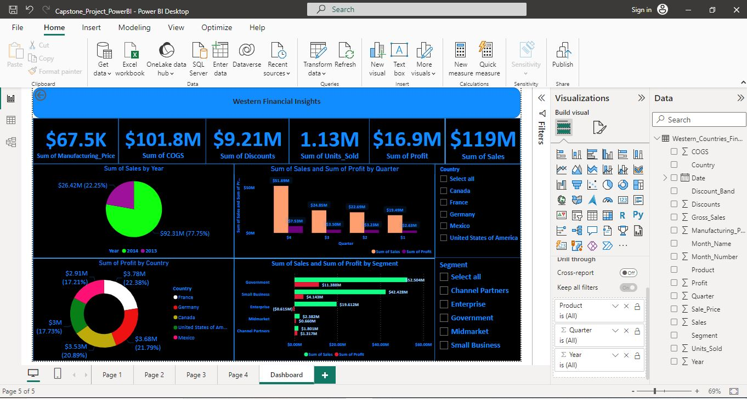
Interactive Dashboard by using visualization tools
Power-BI Dashboard

Slide 9
Conclusion and Inferences
Conclusion :-
Paseo is the top-selling product.
2014 is the year with the highest sales, with a 50% increase compared to the previous year.
2014 recorded the highest profit.
Amarilla is the product with the highest sales among all products.
The Government segment achieves the highest profit. Meanwhile, Enterprise is currently operating at a loss, and we are considering discontinuing business in those countries.
Quarter 4 has the highest sales and profit.

Slide 10
Answers to Key Data Questions
France and Germany are the top 2 most profitable countries.
Carretera, Montana, and Velo are the bottom 3 performing products.
Among all products, Paseo has the highest discount.
2014 had the highest number of units sold.
The Government segment achieved the highest sales with the Amarilla product.
The Government segment achieved the highest profit with the Paseo product.

Slide 11
Endnotes
Reference Links:-
Excel -
https://github.com/rahulpatel1010/Capstone-Project/blob/main/Capstone_Project_Excel.xlsx
SQL -
https://github.com/rahulpatel1010/Capstone-Project/blob/main/Capstone_Project_PowerBI.pbix
Power-BI –
https://github.com/rahulpatel1010/Capstone-Project/blob/main/Capstone_Project_SQL.sql

